Slide 1
NIAHS- PHASE II
Presentation by the Technical Support Unit to
JS (HR) Dr Vishwas Mehta
May 23 2014

Slide 2
NIAHS SO FAR…
Report released in Dec 2012
Ongoing technical support to Ministry of Health and Family Welfare on various allied health and HRH related issues since 2013.
Contract signed to set up a TSU at MoHFW in Feb 2014
Completion of hiring process expected to be completed by the end of May 2014
Activities already being initiated

Slide 3
Major Goals of NIAHS-Technical Support Unit
Establishment of the National Board for Allied Health Sciences
Curricula redesign based on skills and competency approach including assessment protocols as per global standards
Aid Ministry in faculty development and recruitment planning for all courses to be rolled out in NIAHS/RIAHS
Pan-India advocacy and stakeholder sensitization of the allied health profession including liaising with NHM for involving state leadership.
Work to integrate existing associations/bodies/formal groups of allied health professionals such as PT, OT, optometrists etc.
Pilot testing of live register for allied health professionals; goal to eventually roll out to all HHR

Slide 4
Recommended areas for implementation as per Phase-I
Allied Health Regulation, standardization and development through the establishment of an interim body – ‘National Board for Allied Health Sciences’ , to be registered as a society with cabinet approval on the lines of National Board of Examination
1
2
Establishment of the Nine institutes - 1 National and 8 Regional Institutes of Allied Health Sciences across the country (previously named as NIPS and RIPS)

Slide 5
Recommended areas for implementation as per Phase-I
Augmenting supply of skilled Allied Health Workforce by aiding existing medical colleges and allied health institutions to affiliate themselves with the national initiative and increase seat capacity.
3
Standardization of educational and assessment methods across institutions to match international norms – curricula redesign and assessment methods including Common entrance examinations for admissions.
4
Addressing human resource gap and management issues at all levels of healthcare delivery system by increasing sanctioned posts for allied health professionals
5

Slide 6
Additional areas for implementation as per Phase-II
Addressing gap in awareness at all levels of the healthcare system , by advocating the critical role played by allied health professionals in healthcare delivery system through Pan India Advocacy drive for AHPs
6
Addressing lack of health workforce data availability, by launching Live register for Healthcare professionals which will enable policy makers to have real time data related to healthcare professionals
7

Slide 7
National Board for Allied Health Sciences (NBAHS)
As per the implementation plan following task were to be completed by first two quarter of 2014 (June 2014)–
Planned tasks | Status
Drafting of Memorandum of Association and Bylaws for NBAHS and facilitation in registration of the Board | Done (submitted on 12th Nov 2013)
Facilitation in formation of Governing body and related committees | To be initiated after approval from Cabinet
Facilitation in instituting Governing body meetings | To be initiated after approval from Cabinet
Additional technical support provided in the following-
Cabinet note for NBAHS drafted and final version submitted – 8th Jan 2014
EFC document for establishment of NBAHS
Response drafted for the queries raised by the Finance on EFC
Conducted consultation with experts for inputs on MoA and RR

Slide 8
Establishment of Nine institutes
As per the implementation plan following task were to be completed by the end of 2015 –
Planned tasks | Status
On going verification or specification for infrastructural needs in conjunction with Ministry | Under progress
Drafting standards and guidelines for infrastructure requirement for all institutions (besides NIAHS and RIAHS) offering allied health courses. | Initiated dialogue with AFMC and MUHS for first meeting in June first week as well as KUHS and AIMS in Kerala for last week in May 2014
Drafting guidelines for skill training centres | To be initiated after approval of NBAHS from Cabinet
Identification of Centres of excellence for each profession | Done (submitted in phase –I)
Additional technical support provided in the following-
Revised estimates for the faculty positions for the National Institute submitted on – 2nd May 2014

Slide 9
Increase seat capacity
As per the implementation plan – no planned activities for increasing seat capacity
Modified seat capacity for all the RIAHS and NIAHS were submitted in Phase-I
Additional technical support provided in the following-
600 Crore EFC for supporting medical colleges for allied health courses.
Possible intervention for increasing seat capacity-
Stakeholder sensitizing meeting – with public and private institutions (centres of excellences) for increasing seat capacity across the country by engaging institutes as off-sites campus, affiliates and satellite centers.

Slide 10
Standardization of curricula
As per the implementation plan following task were to be completed by third quarter of 2015 –
Planned tasks | Status
Stakeholder meeting with existing bodies implementing standards at various levels (such as NSDC-HSSC, RCI, OCI, to name a few) | 2 meetings conducted with HSSC regarding curricula review, multiple meetings with OCI conducted, RCI to be scheduled.
Desk review of existing curricula - national and international | Desk review format developed and review process initiated on- 118 curricula received by dept. from 10 states 133 curricula received by NIAHS-TSU
Constitution of task force | Proposed curricula review consultation to be undertaken in Nov 2014 Dialogues for participation from international institutions initiated- Sweden, UK, US and Canada Visits planned for next week in Amrita, Thrissur medical college, Kerala University of Health Sciences
Final Approval and Dissemination | Expected to be completed by mid of 2015

Slide 11
Standardization of curricula (contd.)
Additional technical support provided in the following-
Sample framework based on National Vocational Educational Qualification Framework (NVEQF) levels developed for one profession- to be circulated to subject experts for developing similar framework for various professions
Facilitation in formulation of Curricula review committee for first level approval
Facilitation of communication and follow up to various states for curricula submission
Dialogues initiated with various international organisations and institutions for curricula redesign and ToT for master trainers , includiing
Review the current teaching and training methodologies
Development of Teacher Training Curriculum
Identification of training sites for faculty development
Ongoing Planning for large scale advocacy for sensitization of
Consumers
Policy makers – including state authorities
Educational institutes and universities
Professional associations and state regulatory bodies
Students and practicing professionals

Slide 12
Increasing sanctioned posts (contd.)
As per the implementation plan – no planned activities for increasing sanctioned posts.
Possible intervention for increasing sanctioned posts-
Dialogues to be initiated with NHM for possibilities of the same
Mapping of existing positions in public sector across all states.
Uncovering hidden positions through - Allied health career fair (linking professionals with prospective employers)

Slide 13
Pan India Advocacy
As per the implementation plan – plan to be finalized in the kick off meeting
First meeting undertaken with Media and public relations experts – as per the recommendation work in progress (detailing of the implementation activities )– plan to be finalized.
Possible intervention-
Dialogues to be initiated with centres of excellence and experts for the same
Concept note – in progress
Concept note on health conclave (first draft ready)

Slide 14
Global Allied Health Conclave
The event will aim to bring policy makers, beneficiaries, professionals, employers to one single platform so that -
Post-conclave curricula review workshop by global experts can provide final comments on the competencies
Advocacy of existing Allied Health Courses in India can be undertaken at a global platform
Highlighting- career development pathway for professionals – national and international
On site admissions by various AHS Institutes and Universities.
Registration for interviews by various prospective employers
Government –recognised centers of excellence may be showcased
NIAHS and RIAHS updates may be provided to prospective students

Slide 15
Flow of event
Pre- Registration for Event/Fair
12th Students/ Interested candidates
Candidates’ persuing Allied Health profession
Professionals from Allied Health Sciences
Conferences- policy dialogue, poster and oral presentations, Panel discussions and carrier growth prospects
Exposure of various colleges, Institutions and Universities offering Allied Health Courses.
Exposure of Hospitals and Companies for existing Professionals
On the spot registrations for admissions by colleges, institutions and universities
(Online) Live Registration of Allied Health Professionals with online CV submission
Feedback from hospitals for conducting INTERVIEWS & from colleges/ Universities for ADMISSIONS.

Slide 16
Live registry for Health Professionals
As per the implementation plan – plan to be finalized in the kick off meeting
First meeting undertaken with IT experts– as per the recommendation - format developed - plan to be finalized in the kick off meeting.
Possible intervention-
Concept note – in progress (first draft ready)

Slide 17
Purpose
To enumerate number of active healthcare professionals practicing in the country for policy planning.
This register would be an online register, where healthcare professionals can self register by filling an online form with their nominal details.
This register would help the stakeholders in better planning and project for the professionals so that these professionals are fully benefitted. By tracking the actual numbers of the healthcare professionals, human resources which are discreetly scattered throughout the country mainly in urban area can be evenly distributed as per the need and requirement of the society.

Slide 18
Purpose
In additional to this , live register will provide an opportunity to the professionals for employment as well as employers will gain access to large set of skilled professionals -
Hospitals and companies with the immense need of such professionals will be registered with the National Registry to gain access to the large group of professionals for recruitment purposes.
Prior consent from the professionals will be taken for sharing the data with the potential employers.

Slide 19
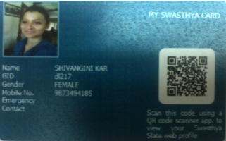
Layout of the Online Self Registration
National Registry of Healthcare Professionals
Photo
Online Healthcare Professional Registry
E-card for Healthcare Professionals

Slide 20
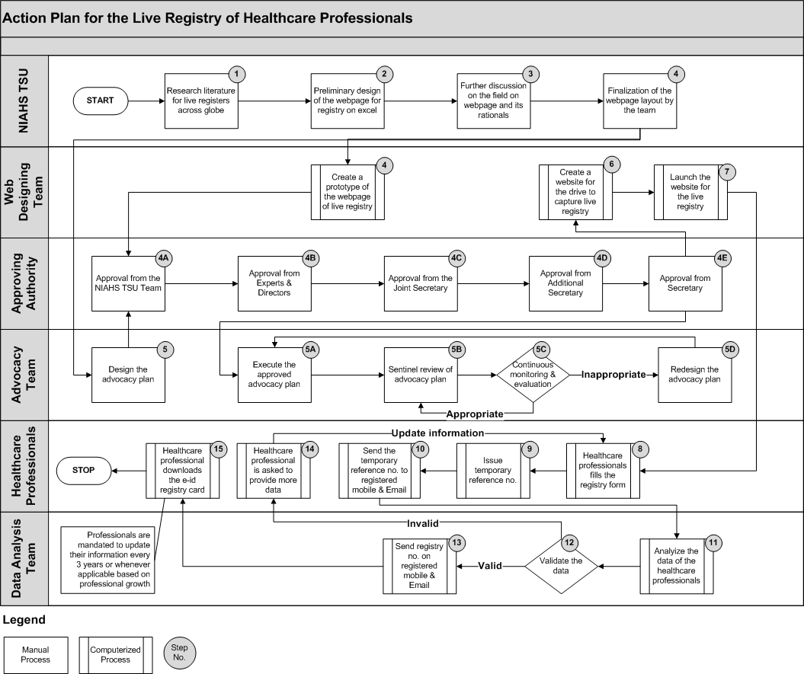

Slide 21
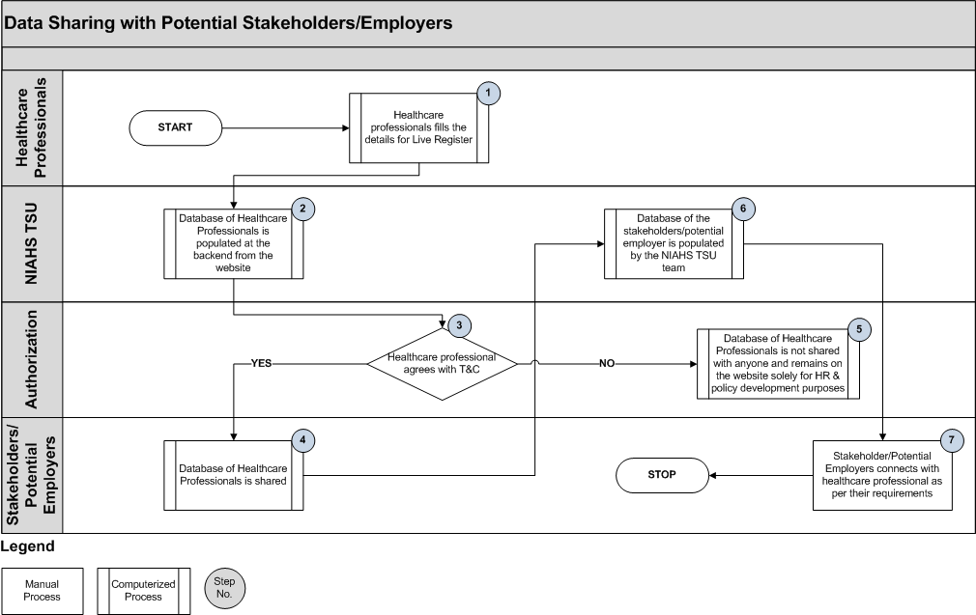

Slide 22
Additional technical support- Medical Education
Prepared summary notes for the ‘Hearing Committee’ based on the observation made by MCI for 687 PG Courses of 139 colleges.
Compiled the recommendations made by ‘Hearing Committee’ to the medical institutions.
Prepared disapproval and conditional letters of permission for medical colleges.
Prepared a college wise data regarding approved and disapproved schemes
Preparing a database of medical colleges those who have sent proposals to MoHFW for increasing/ starting of PG seats.( Proposal 2015-16 xls dat.xlsx )
National post graduate seat analysis for medical colleges across India based on MCI data.

Slide 23
Additional technical support- Nursing
Prepared a brief note based on the report furnished by core committee on amendment in INC act.
Prepared a presentation on current scenario of Nursing status in India.
Updated the ANM and GNM schools database for the department

Slide 24
Daily records of consultants

Slide 25
Immediate next steps
Complete recruitment process
Undertake a planning workshop In the next 2 weeks with all key experts for a detailed work plan and discussion on regulatory issues (Clinical Establishment Act, etc.)
Work on the curriculum basic requirement framework based on all the information received (first review to be completed by second week July)
Engage with the key associations (IAP, OCI etc.) and state councils, where applicable for further standards
Continue to provide the necessary documentation to cabinet for NBAHS approval
Continue technical support

Slide 26
DISCUSSION AND CONCLUSION

